Slide 1

Cuse Alumni Groves

Slide 2


Slide 3


Slide 4
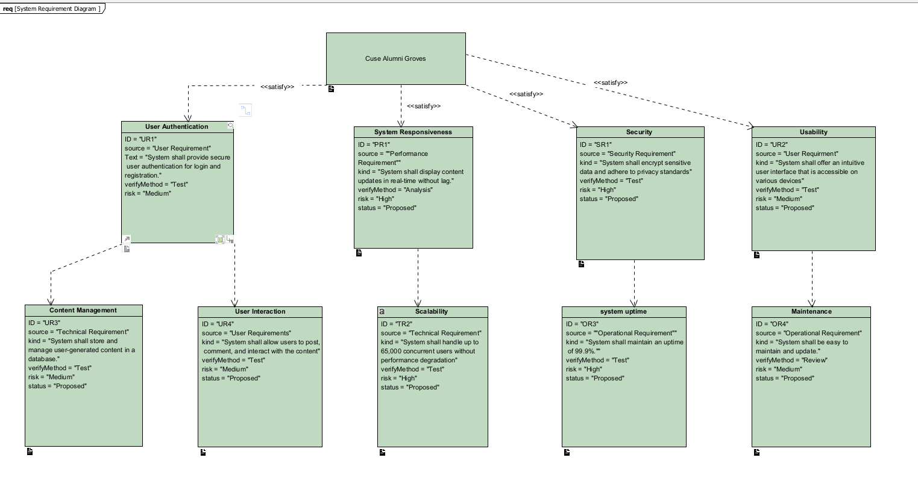
Requirement Diagram for Activity Diagram

Slide 5
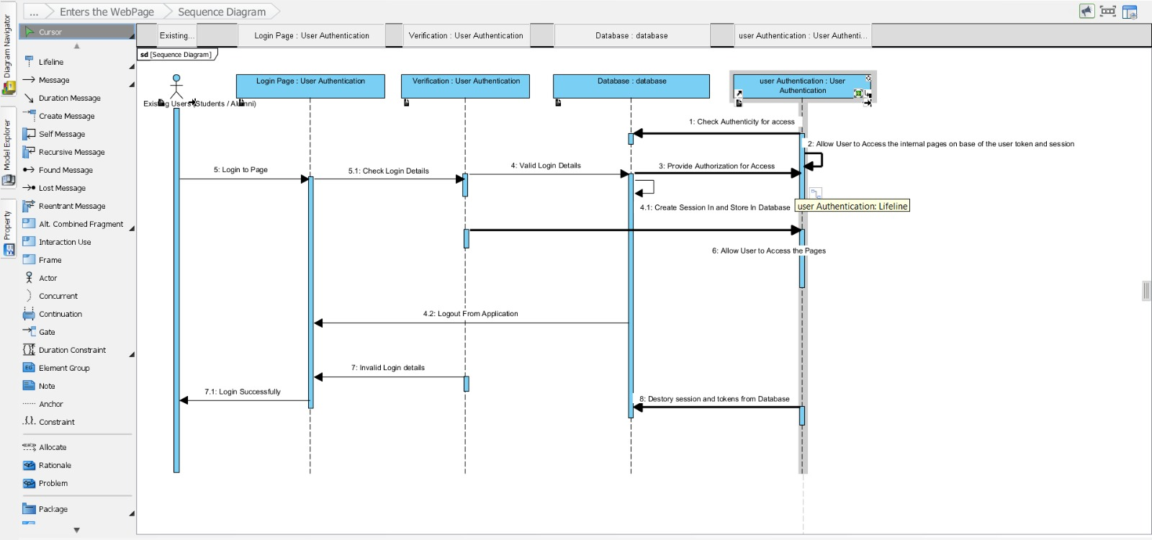
Sequence Diagram

